Slide 1
V440 Klassifisering av bruer basert på Lenkede data og Semantisk Web teknologi
Lars Wikström, Triona AB
2020-06-30

Slide 2
Agenda
Linked data & Semantic web – Crash course
Några länkar för att läsa mera
Genomgång v440-ontologierna
Genomgång web-access
Några kod-exempel (C# och Python)

Slide 3
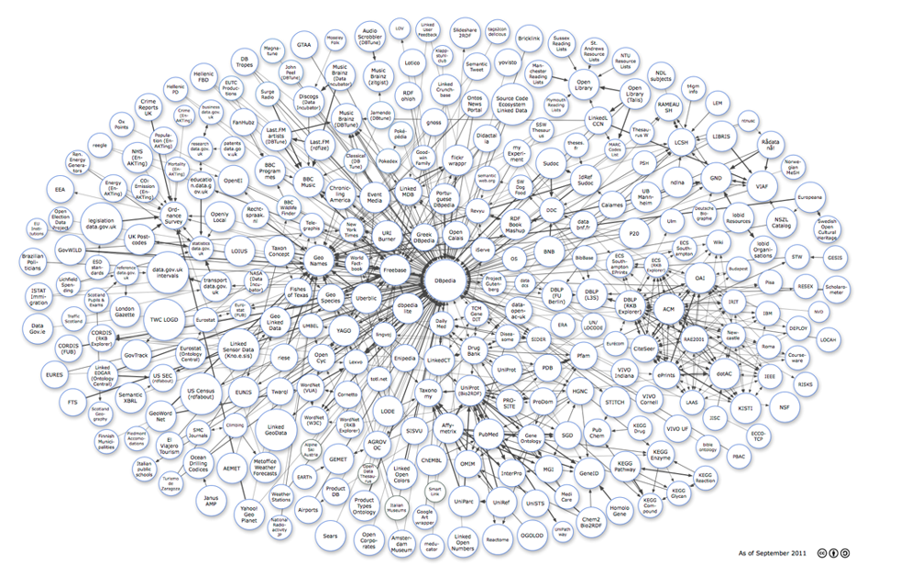
Linked Data & The Semantic Web – Crash course (~10 mins)
http://www.w3.org/standards/semanticweb/

Slide 4

Linked data – starting with the web (linked documents) Physical machines abstracted away
URL
URL
URL
URL

Slide 5
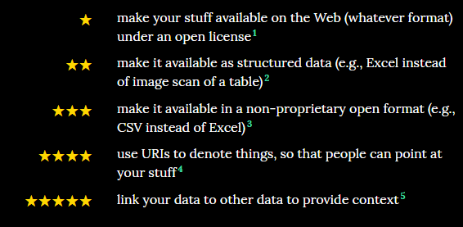
Linked data - Semantic Web (Web of data)

Slide 6
Basic concepts
RDF
Resource Description Framework
RDFS
Resource Description Framework Schema
SPARQL
SPARQL protocol and RDF Query Language
OWL
Web Ontology Language

Slide 7
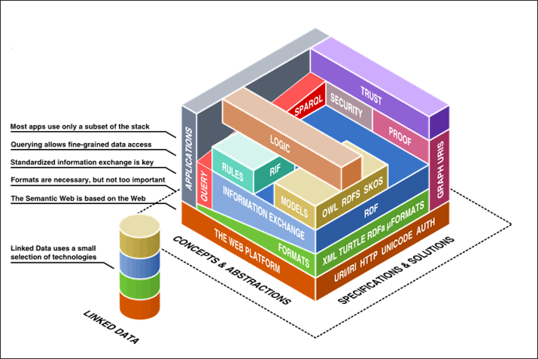
Technology Stack – Web technology

Slide 8

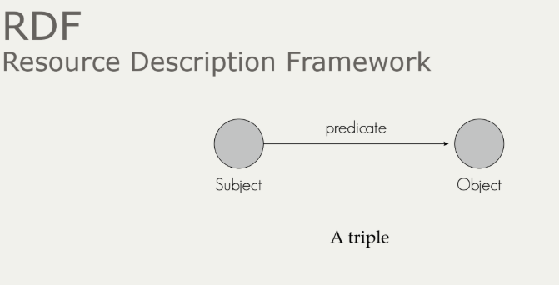
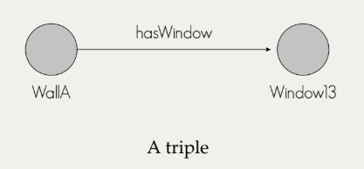
Basic Concepts
RDF – Resource Description Framework
:WallA
:hasWindow :Window13 .
A Fact!

Slide 9
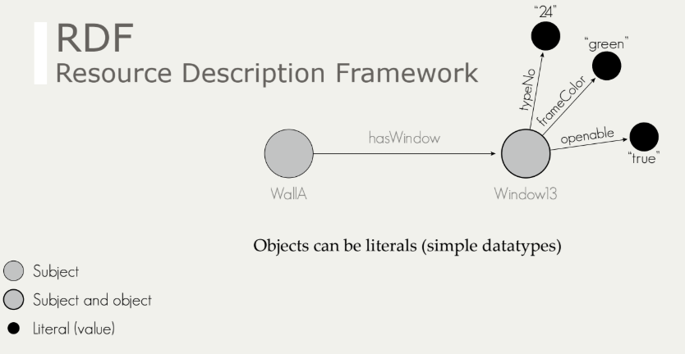
Basic Concepts
:WallA
:hasWindow :Window13 .
:Window13
:typeNo “24” ;
:frameColor “green” ;
:openable “true” .

Slide 10
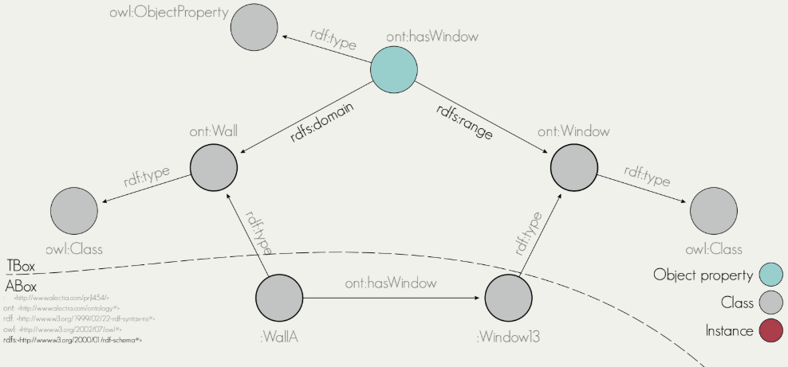
Basic Concepts
:WallA
rdf:type ont:Wall ;
:hasWindow :Window13 .
:Window13
rdf:type ont:Window .
ont:hasWindow
rdf:type owl:ObjectProperty ;
rdfs:range ont:Window ;
rdfs:domain ont:Wall .
rdf: = http://www.w3.org/1999/02/22-rdf-syntax-ns
rdfs: = http://www.w3.org/2000/01/rdf-schema
RDFS – RDF Schema

Slide 11
RDF/RDFS – important concepts
Classes:
rdfs:Class – ”the class of resources that are RDF classes”
rdfs:Literal – “the class of literal values such as strings and integers”
rdfs:Datatype – “the class of datatypes”
rdf:Property – “the class of RDF properties”
Properties:
rdf:type – “states that a resource is an instance of a class”
rdfs:range – “states that the values of a property are instances of a class”
rdfs:domain – “states that the any resource that has the property is an instance of a class”
rdfs:subClassOf – “states that all instances of one class are instances of another”
rdfs:subPropertyOf – “states that all instances related by one property are also related by another”
rdfs:label – “used to provide a human-readable version of a resource’s name”
rdfs:comment – “used to provide a human-readable description of a resource”

Slide 12

Basic Concepts
SPARQL – Querying the semantic web
SELECT ?wall ? Window
WHERE {
?wall rdf:type ont:Wall .
?wall ont:hasWindow ?window .
}
https://jena.apache.org/tutorials/sparql.html
Några v440-exempel senare…

Slide 13
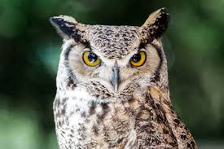

Basic Concepts
owl: = http://www.w3.org/2002/07/owl
OWL – Ontologies (RDFS++)
Web Ontology Language
OWL includes RDFS plus much more:
E.g. Class “Mother” is the intersection of classes “Parent” and “Woman”
E.g. My class “Wall” is equivalent to the class “IfcWall”
E.g. System-A:BridgeA is the same as System-X:BridgeX
OWL allows you to easily express the relationships between different ontologies using a standard annotation framework.
Semantic reasoning
Inferring new triples (knowledge) from existing triples
E.g. This individual belongs to “Parent” and “Woman” => Must be a “Mother”
Mother
Woman
Parent
rdf:type
rdf:type
rdf:type

Slide 14
OWL – Important concepts
owl:Class – “defines a group of individuals that belong together because they share some properties. owl:Class is a subclass of rdfs:Class”
owl:Restriction – “is defined as a subclass of owl:Class. A restriction class should have exactly one triple linking the restriction to a particular property, using the owl:onProperty property”
owl:DatatypeProperty – “one of two main categories of properties. It links individuals to data values”
owl:ObjectProperty – “one of two main categories of properties. It links individuals to individuals”

Slide 15
OWL – Important concepts
owl:intersectionOf – “the class extension contains precisely those individuals that are members of the class extension of all class descriptions in the list”
owl:unionOf – “the class extension contains those individuals that occur in at least one of the class extensions of the class descriptions in the list”
owl:complementOf – “a class for which the class extension contains exactly those individuals that do not belong to the class extension of the class description that is the object of the statement”
owl:equivalentClass – “class description has exactly the same class extension as another class description”
owl:disjointWith – “the class extension of a class description has no members in common with the class extension of another class description”

Slide 16
OWL – Important concepts
owl:equivalentProperty – “two properties have the same property extension”
owl:equivalentClass – “class description has exactly the same class extension as another class description”
owl:disjointWith – “the class extension of a class description has no members in common with the class extension of another class description”
owl:inverseOf – “relationship between owl:ObjectProperty such that for every pair (x,y) in the property extension of P1, there is a pair (y,x) in the property extension of P2, and vice versa”
owl:FunctionalProperty – “a property that can have only one (unique) value y for each instance x”
owl:TransitiveProperty – “if a pair (x,y) is an instance of P, and the pair (y,z) is also instance of P, then we can infer the the pair (x,z) is also an instance of P.”
owl:SymmetricProperty – “if the pair (x,y) is an instance of P, then the pair (y,x) is also an instance of P.”

Slide 17
OWL – Read more and learn
OWL language guide : https://www.w3.org/TR/owl-guide/
Protégé pizza tutorial : http://mowl-power.cs.man.ac.uk/protegeowltutorial/resources/ProtegeOWLTutorialP4_v1_3.pdf

Slide 18
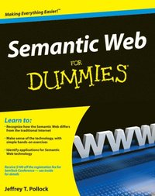
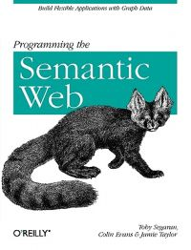
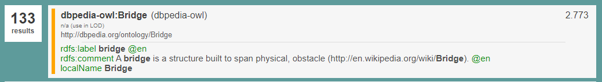
LD/SW – Read more and learn
W3C - OWL language guide
Intro
5 star open data
Semantic web for dummies
Programming the semantic web
Linked Open Vocabularies
Protégé pizza tutorial
DBPedia SPARQL endpoint
Linked Geodata
SPARQL Endpoint
LinkedDataHub

Slide 19
Varför en ontologi för V440?
Make the structure of V440 explicit and machine readable
Using RDF, RDFS, OWL as a FORM FOR REPRESENTATION, keeping the essence intact!
Directly referenceable from other standards/formats such as IFC & *GML
Through the use of URI:s
Easily ”mappable” to other structures
Through ”Linking Rule Sets”, or ”Alignment ontologies”, i.e. ontologies of their own right, specifying schema level relationships between concepts
Available through standard Web API:s
http GET, SPARQL endpoint
For free comes:
Exchange format for both schema and data (XML, Json, Turtle, …)

Slide 20
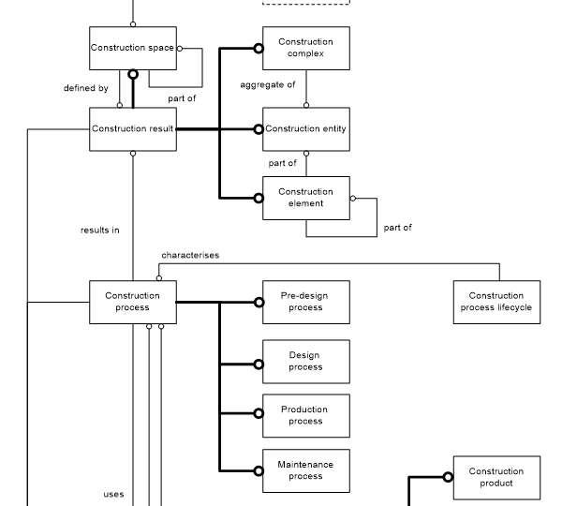
Inspiration from ISO 12006-2 Building construction — Organization of information about construction works — Part 2: Framework for classification
Construction complex
aggregate of construction entities serving at least one user activity or function
Construction entity
an independent unit of the built environment with a characteristic spatial structure, serving at least one user activity or function
Construction Entity part
constituent of a construction entity
Construction element
constituent of a construction entity with a characteristic technical function, form or position
Construction process
process which uses construction resources to achieve construction results

Slide 21
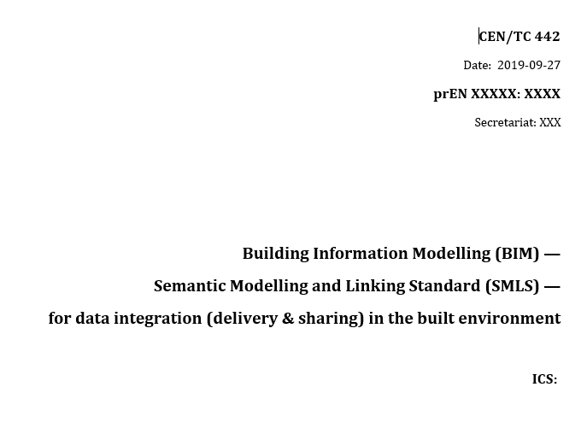
A pilot for CEN/TC442 Semantic Modelling and Linking Standard - Including the basicsemantics ontology

Slide 22
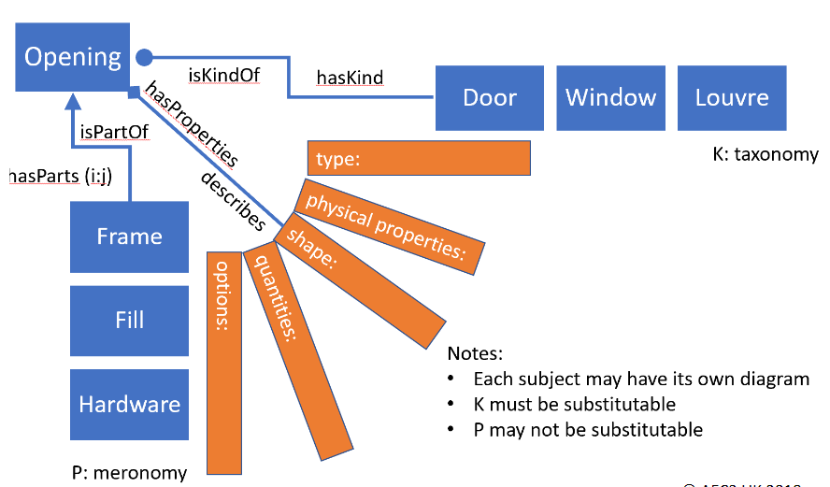
Basic concepts used in RDF, RDFS and OWL
v440:Vegbru
rdf:type owl:Class ;
v440:avsnitt "V-5.1" ;
v440:kapitel " V-5" ;
v440:kode "1"^^xsd:int ;
rdfs:label "Vegbru"@no ;
rdfs:subClassOf v440:Ordinar_bru_i_dagen ;
.
URI:s identify each concept
Define the concepts
owl:Class, rdfs:label, rdfs:comment
Define the taxonomy (isKindOf)
rdfs:SubClassOf
Define the meronomy (isPartOf)
basicsemantics:hasPart (CEN/SMLS)
Define the properties
owl:xxxProperty
Connect properties and classes
rdfs:domain/rdfs:range
Define Annotation
E.g. capture the ”Codes” and other info from V440

Slide 23
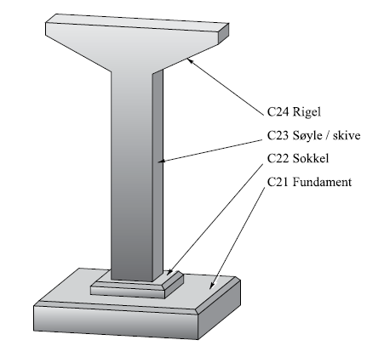
A challenge
The handbook defines a hierarchical structure of classes/codes, but
It is not always strict with regards to the nature of the hierarchy
E.g. taxonomies vs meronomies
rdfs/owl needs to support reasoning and to be ”semantically strict”
A class is a set
rdfs:subClassOf specifies a subset (used for taxonomies)
Example: Pillar
In V440 there is no clear difference beteen
The relationship between BuildingElement vs Pillar (is-a)
And the relationship between Pillar and Foundation (has-a)

Slide 24


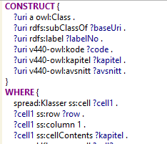


The process
Understand
V440
Define principles
Verify principles with domain experts
Verification
Validation
Generate V440 ontology using SPARQL/SPIN
Define Excel structure
Bulk input from domain experts
Convert excel to rdf (generic spreadsheet structure)

Slide 25
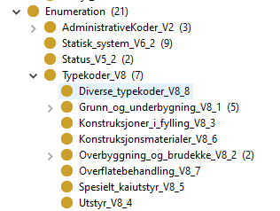
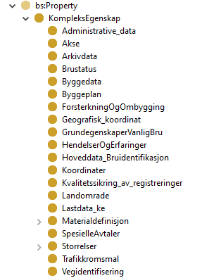
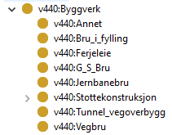
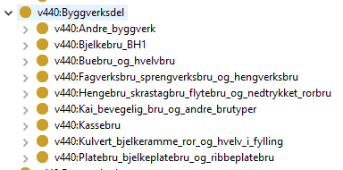
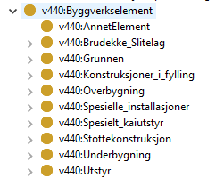
Ontology
Properties (=Kap. 7 – Brudata)
Construction entity (=Byggverkskategori)
hasPart
hasPart
Construction entity part (=Byggverkstype)
Construction element (=Byggverkselement)

Slide 26
GitHub – v440 wiki walkthrough
Link : https://github.com/buildingsmart-norway/maskinlesbar_v440

Slide 27
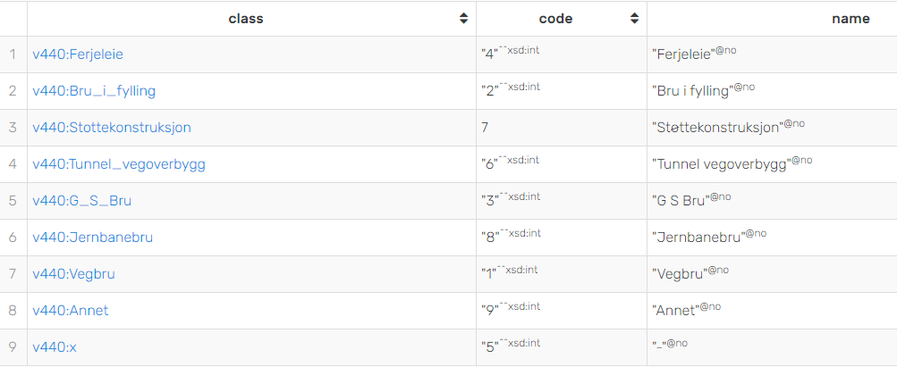
SPARQL – Alla byggverk
prefix rdfs: <http://www.w3.org/2000/01/rdf-schema#>
prefix owl: <http://www.w3.org/2002/07/owl#>
prefix onto: <http://www.ontotext.com/>
prefix v440: <http://rdf.vegdata.no/V440/v440-owl#>
prefix v440bd: <http://rdf.vegdata.no/V440/v440-brudata-owl#>
select distinct ?class ?code ?name
where
{
?class rdfs:subClassOf+ v440:Byggverk .
?class rdfs:label ?name .
?class v440:kode ?code .
}

Slide 28
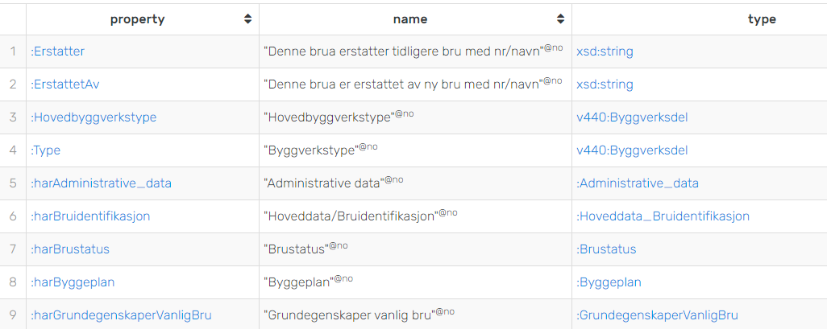
SPARQL – Properties (v440:Vegbru)
prefix rdfs: <http://www.w3.org/2000/01/rdf-schema#>
prefix owl: <http://www.w3.org/2002/07/owl#>
prefix onto: <http://www.ontotext.com/>
prefix v440: <http://rdf.vegdata.no/V440/v440-owl#>
prefix v440bd: <http://rdf.vegdata.no/V440/v440-brudata-owl#>
select distinct ?property ?name ?type
where
{
?property rdfs:domain ?class .
?property rdfs:label ?name .
v440:Vegbru rdfs:subClassOf* ?class.
OPTIONAL {?property rdfs:range ?type .}
OPTIONAL {?property rdfs:subPropertyOf*/rdfs:range ?type .}
}

Slide 29
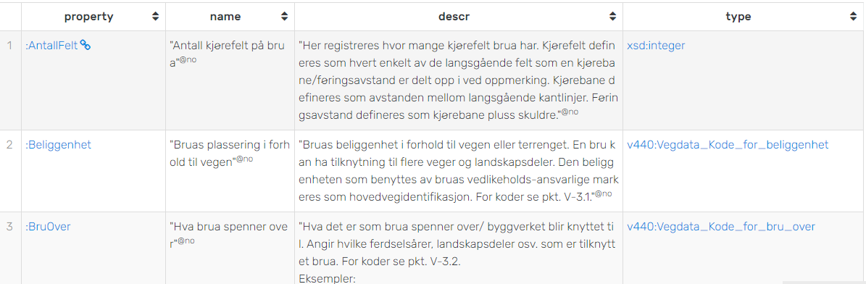
SPARQL – Komplekse properties
(v440bd:Vegidentifisering)
prefix rdfs: <http://www.w3.org/2000/01/rdf-schema#>
prefix owl: <http://www.w3.org/2002/07/owl#>
prefix onto: <http://www.ontotext.com/>
prefix v440: <http://rdf.vegdata.no/V440/v440-owl#>
prefix v440bd: <http://rdf.vegdata.no/V440/v440-brudata-owl#>
select distinct ?property ?name ?descr ?type
where
{
?property rdfs:domain ?class .
?property rdfs:label ?name .
?property rdfs:comment ?descr .
v440bd:Vegidentifisering rdfs:subClassOf* ?class.
OPTIONAL {?property rdfs:range ?type .}
OPTIONAL {?property rdfs:subPropertyOf*/rdfs:range ?type .}
OPTIONAL {?type rdf:type ?dt .}
}

Slide 30
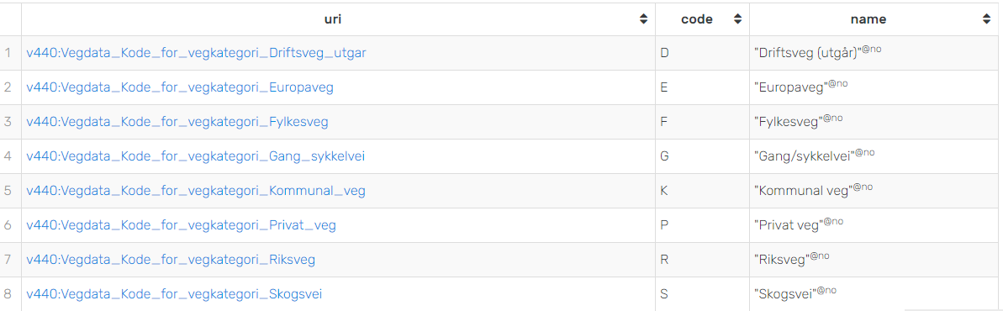
SPARQL – Kodeliste
prefix rdfs: <http://www.w3.org/2000/01/rdf-schema#>
prefix owl: <http://www.w3.org/2002/07/owl#>
prefix onto: <http://www.ontotext.com/>
prefix v440: <http://rdf.vegdata.no/V440/v440-owl#>
prefix v440bd: <http://rdf.vegdata.no/V440/v440-brudata-owl#>
select distinct ?uri ?code ?name
where
{
?uri a v440:Vegdata_Kode_for_vegkategori .
?uri v440:kode ?code.
?uri rdfs:label ?name.
}

